Slide 1
HDFC Bank Freedom Credit Card
Credit card for first-time cardholders

Slide 2
Why HDFCs Freedom Card?
Who is this for? This is best-suited credit card for first time users
Why is it a good choice? Card offers bonus reward points on groceries, movies, food orders. Conversion of earned reward points against statement credit is easy and great feature to avail cashback insead of rewards
What is the minimum requirement for availing this card? Salaried: Rs. 12,000 p.m. Self-employed: ITR> Rs. 6 lakh p.a.

Slide 3
Features

Slide 4

Joining Fees
Rs. 500/-
One time Joining fee

Slide 5

Fees waived off
Rs. 500/-
Waived off on spending Rs. 50,000 in a year

Slide 6
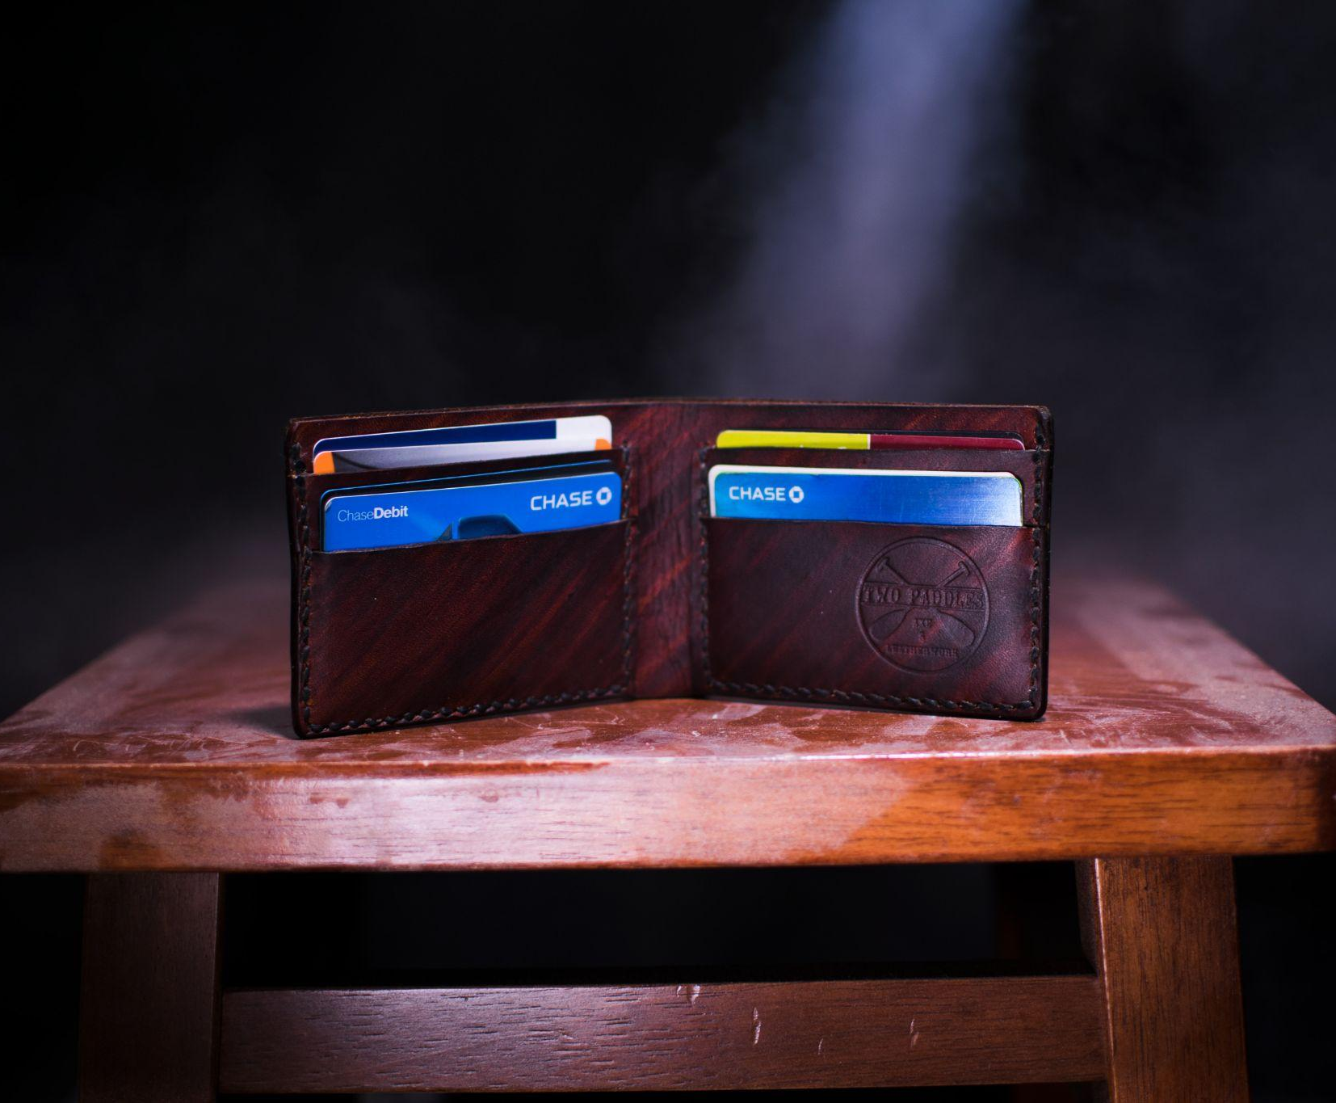
Interest charges
3.6% per month
43.2% per annum), 0.99% for the first 90 days

Slide 7
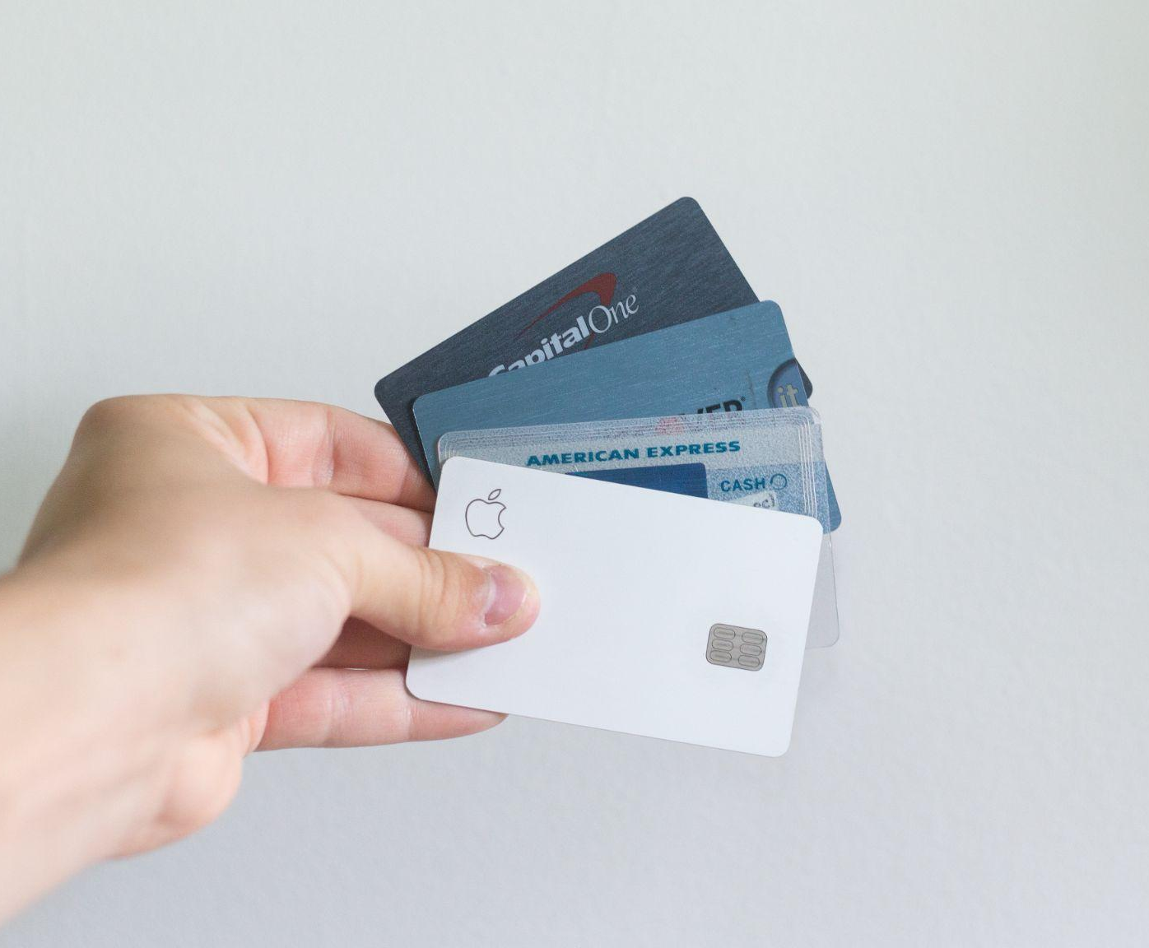
Card replacement fees
Rs.100
Fee for reissue of a stolen, lost or damaged card

Slide 8

Foreign currency markup fees
3.5%
3.5% on the conversion amount (plus applicable taxes)

Slide 9

Rewards
Multiple rewards:
Welcome benefit of 500 reward points
Birthday spends, get 25X reward points
Enjoy 5X reward points movies, grocery spends

Slide 10

Redeem cashpoints
Rs. 99/-
Rs.99 per redemption request

Slide 11

Fuel surcharge waiver
1% fuel surcharge waived off
Rs.250 per statement cycle will be waived off

Slide 12
Feature Snapshot
Parameters | Details
Joining fees | Rs. 500 (plus applicable taxes)
Spend based waiver | Renewal fee waived off if a minimum of Rs. 50,000 were spent in the previous year
Rewards redemption fee | Rs. 99 per redemption request (plus applicable taxes)
Interest Rate | 3.6% per month
Fuel Surcharge | 1% fuel surcharge waived off at all filling stations

Slide 13
Application Process

Slide 14
Application Process
You can apply for using two ways
Visiting the bank
Visit the bank nearest branch where you have taken the education loan
Fill up the form - Credit Card application form
Submit the KYC documents - Whatever mentioned.
Get your card
Apply online:
Visit the ‘Apply card’ link
Specify your details
Get your card

Slide 15
Comparison of two similar cards

Slide 16
HDFC’s Freedom Credit Card vs SBI’s Unnati Card
Parameters | Freedom Credit Card | Unnati Card
Joining fee | Rs. 500 (plus applicable taxes) | Nil
Interest - Free period | 20-50 Days | Upto 50 days
Renewal Fees | Rs. 500 (plus applicable taxes) | Spend 50,000+ in a year to waiver off the fees next year

Slide 17
Why is freedom Card the best?
Enjoy 5X reward points on your dining, grocery, railway bookings, taxi bookings, and movie spends
Make the most of your birthday with 25X reward points on your expenses made with the card
On your purchases made on PayZapp and SmartBUY, get 10X reward points
Gift voucher of Rs.1,000 on spending more than Rs.90,000 in a year
Renewal fee is waived off is annual spends is more than Rs.50,000
Interest-free period of up to 50 days.

Slide 18
Thank You

